Slide 1

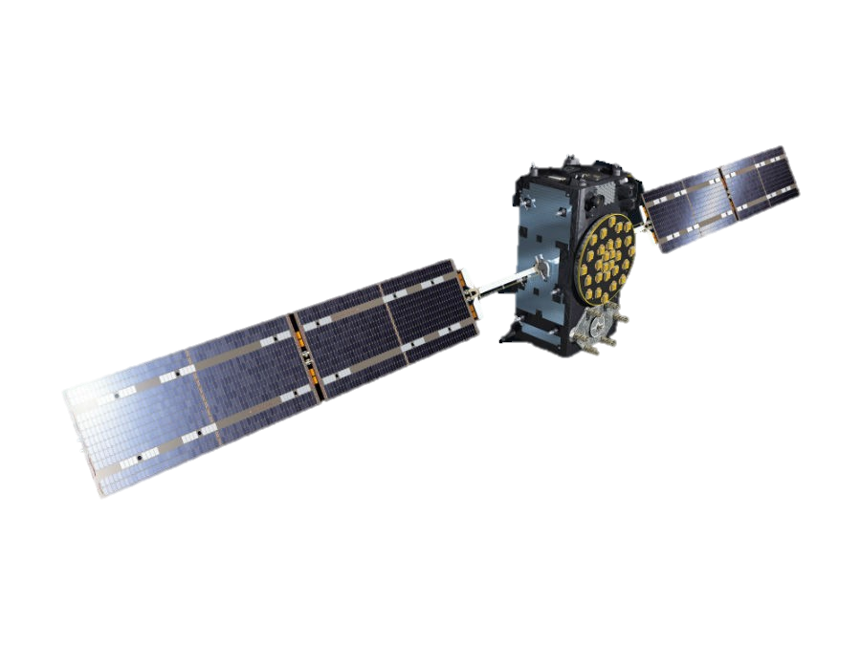
Machine Learning for Spacecraft Telemetry Anomaly Detection
Eric Jackson
https://www.esa.int/ESA_Multimedia/Images/2015/09/Artist_s_view_of_a_Galileo_Full_Operational_Capability_FOC_satellite

Slide 2
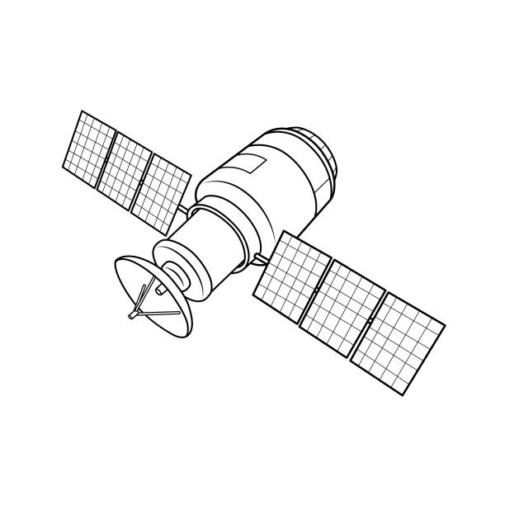
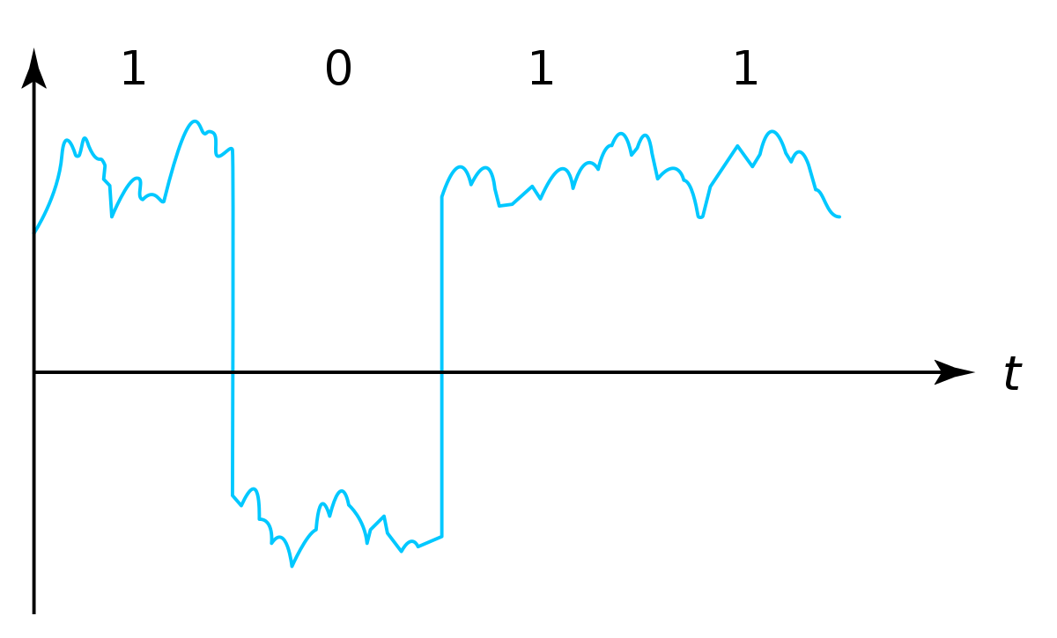



Agenda
Problem Statement
Background
Models and Methods
Initial Work
Additional Work
Results
Conclusions

Slide 3
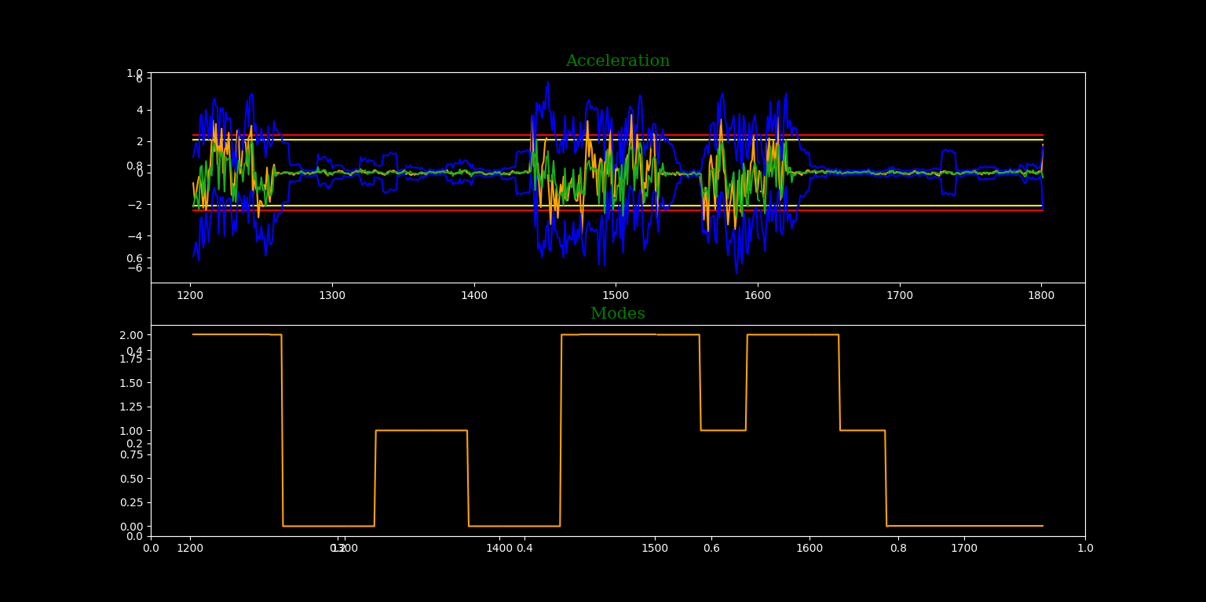
Problem statement
Spacecraft generally have thousands of telemetry mnemonics monitoring every aspect of the vehicle and can have a fault occur due to one or many samples appearing anomalous at any time. Fault protection will put the vehicle in an off-nominal state, usually until human intervention is performed. This downtime of satellites can add up to weeks every year, and human cost associated with that in the hundreds of thousands of dollars. Machine learning can and is being used to both predict and identify anomalous data points in telemetry in order to prevent or limit an outage. An attempt to optimize current methods will be performed based on previous papers by using statistical and mathematical predictions with full and reduced sets of data.
https://devpost.com/software/ml-for-satellite-anomaly-detection

Slide 4
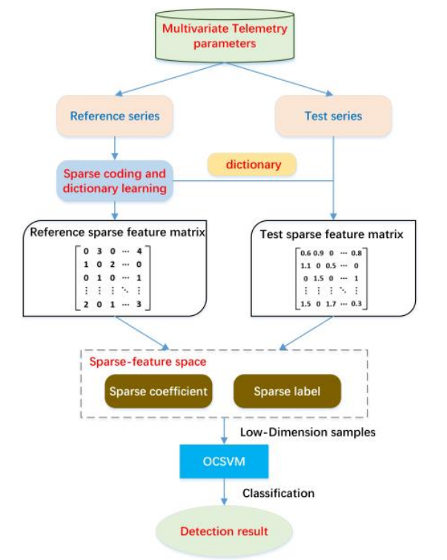
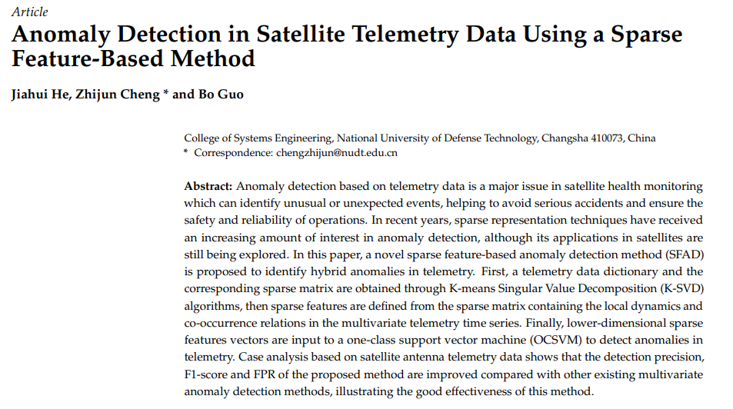
Background: paper/research
He, J.; Cheng, Z.; Guo, B. Anomaly Detection in Satellite Telemetry Data Using a Sparse Feature-Based Method. Sensors 2022, 22, 6358. https://doi.org/10.3390/ s22176358

Slide 5
Background: Original motivation
Spacecraft have onboard anomaly responses for most known failure cases to safe the vehicle
Normally low/high, red/yellow limits set for certain monitors with corresponding response (either automatic or visual alarm)
Some anomalies can be hard to predict, and multiple components can react slightly out of family to create larger issue
Benefits of utilizing machine learning for spacecraft:
Prevents loss of mission over potentially high priority targets
Automatic response would limit both downtime and human interaction
Higher award/incentive fees for lower mission outage percentage
Limits time spent by operators and factory investigating and implementing a fix
Depending on program and customer, recovery can take anywhere from a few hours to multiple days
Predict future anomalous conditions and potentially react before an issue were to occur
Some programs have multiple vehicles on orbit meaning there is a plethora of historical training data available
Goal: Utilize ARIMA & OCSVM to create a hybrid anomaly detection method and compare results with other common algorithms/methods
Anomaly

Slide 6
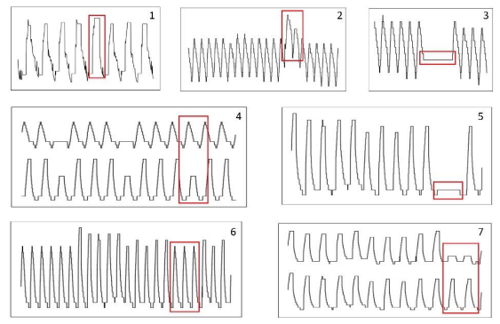
Background: anomaly definition
Types of anomalies
Single sample transient anomaly; small group of points that are noticeably different from surrounding data (2)
Collective anomaly; group of points that do not exceed threshold(s) but together are irregular (1, 3, and 5)
Contextual anomaly; anomalous points only in a certain context (6)
Correlation anomaly; occurs when correlation between parameters change (4 and 7)

Slide 7
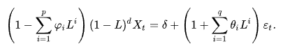
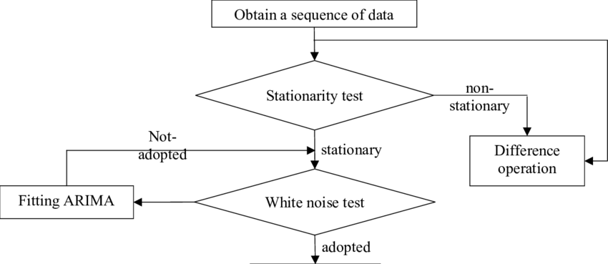
Auto Regressive Integrated Moving Average (ARIMA)
Most machine learning algorithms struggle with time series data
Prone to overfitting, generally time series datasets are small compared to common ML uses (image data, voice data, etc)
ARIMA is a statistical based model specifically for forecasting time series data
3 input hyperparameters (with 3 additional but same parameters for seasonal or SARIMA modeling)
p = order of auto-regressive model
d = order of first-differencing
q = order of moving-average model
ARIMA works best with stationary data, meaning that most inputs will need to be differenced before running model
Augmented Dickey-Fuller (ADF) test checks for stationary data by looking if a unit root is present in the data
https://www.researchgate.net/publication/336549097_The_application_of_ARIMA_model_in_forecasting_population_data

Slide 8
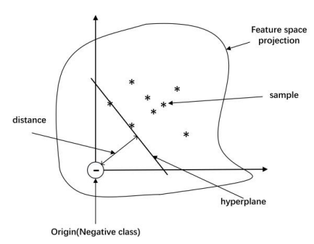
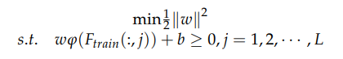
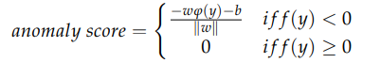
One Class Support Vector Machine Algorithm (OCSVM)
Once model has been trained and a forecast of data has been generated, potential outliers/anomalies need to be identified
Concept:
Unsupervised method maps samples of a higher-dimensional subspace and find a hyperplane separating one-class samples from origin (maximizing distance)
Splits data into positive and negative classes and tries to minimize volume of training data in positive class
Advantages:
Highly efficient
Requires few hyperparameters from user
Eliminates need for labelled two-class information during training
https://www.researchgate.net/publication/362912442_Anomaly_Detection_in_Satellite_Telemetry_Data_Using_a_Sparse_Feature-Based_Method/figures?lo=1
Hyperplane found by solving:
Notes:
Good for telemetry data because anomalies are somewhat rare

Slide 9
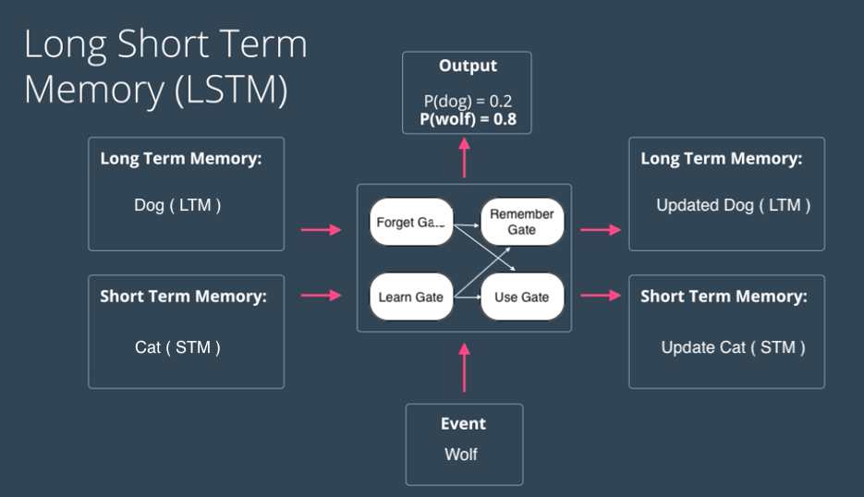


Additional ML models used for forecasting
Several deep learning methods used to compare with ARIMA results:
Convolutional neural network (CNN):
Artificial neural network which uses convolution (extra function output that describes shape of input functions) instead of matrix manipulation
Made up of Input/Hidden/Output layers with the hidden layers performing convolutions. Also called Convolutional/Pooling/Full-Connected layers
Long Short Term Memory (LSTM):
Artificial neural network which improves on RNN architecture
Able to learn, unlearn, and retain information with each state change
Forget/Input/Output gates control “direction” of data
Support Vector Regression (SVR):
Very similar to OCSVM, but is a regression model whereas OCSVM is a classifier
Finds optimal hyperplane which passes through as many data points as possible while minimizing the prediction error
LTSM Diagram
SVR Diagram
CNN Diagram
https://editor.analyticsvidhya.com/uploads/71819Screenshot%202021-01-19%20at%2011.41.29%20PM.png
https://miro.medium.com/v2/resize:fit:600/1*Fjj7EblDs2J88GgJmyKL8w.png
https://www.researchgate.net/publication/336805909/figure/fig1/AS:817888827023360@1572011300751/Schematic-diagram-of-a-basic-convolutional-neural-network-CNN-architecture-26.ppm

Slide 10
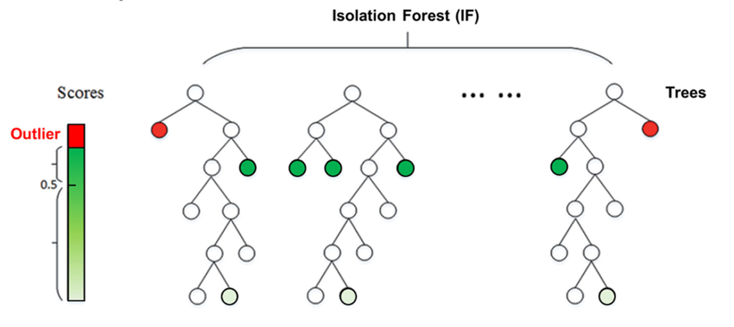
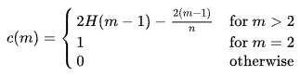
Additional outlier detection: Isolation Forest
Isolation Forest used as second outlier/anomaly detection method to compare OCSVM results with
Detects outliers utilizing binary trees
Low memory utilization
Works best with large datasets
Recursively partitions data points based on randomly selected attribute
Assigns anomaly scores based on number of “splits” needed to isolate data point
Training dataset used to build trees, validation data is then passed through these trees and assigned anomaly score
https://wiki.datrics.ai/isolation-forest-model
Anomaly Score:

Slide 11
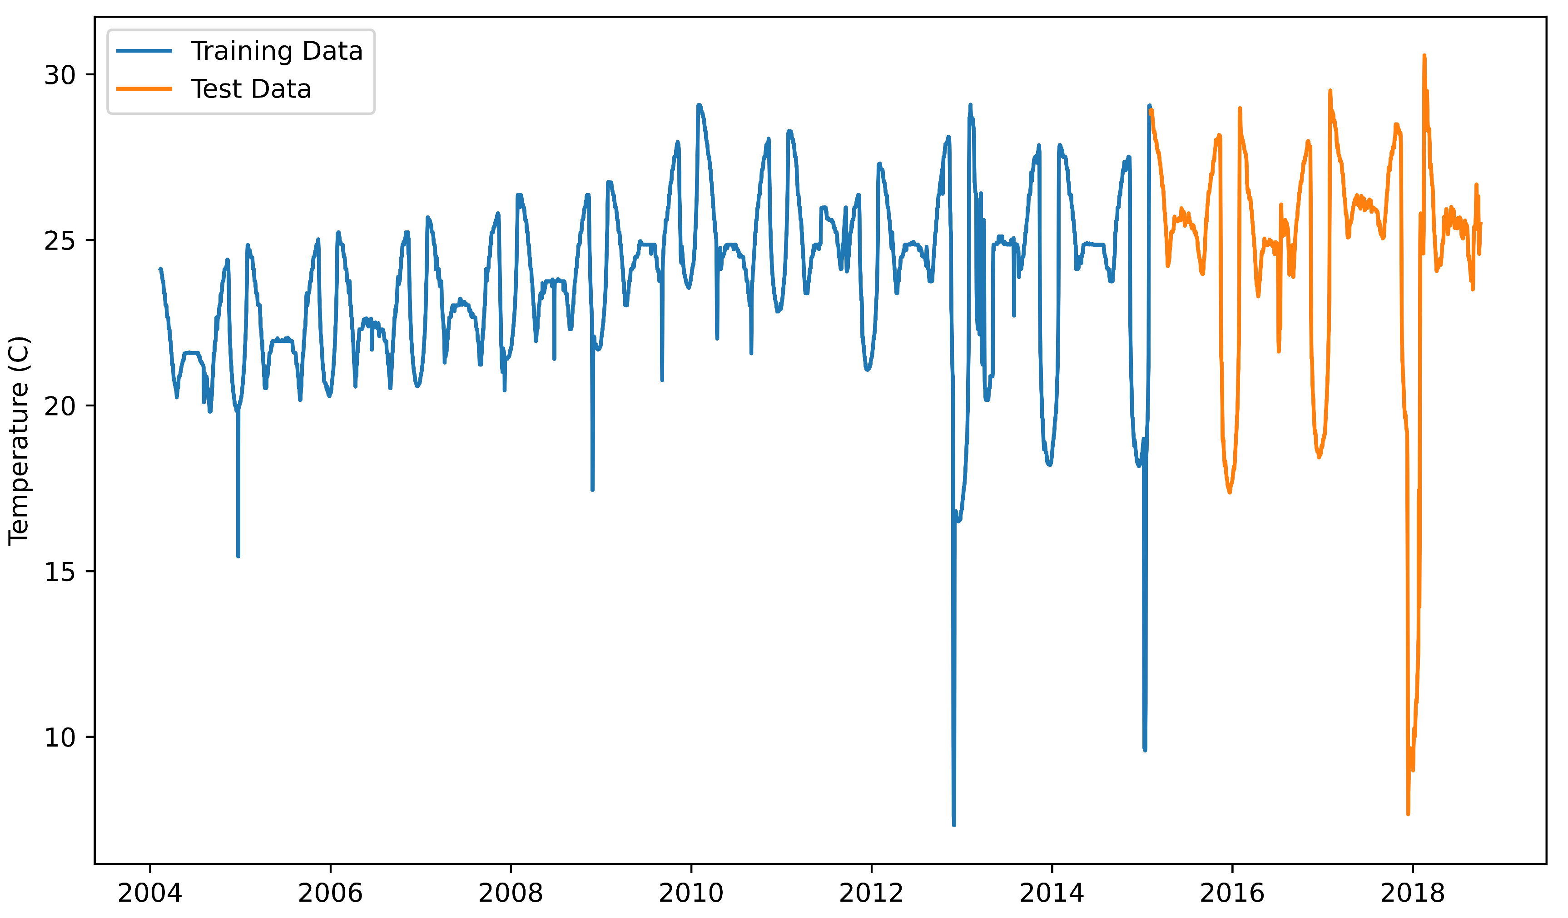
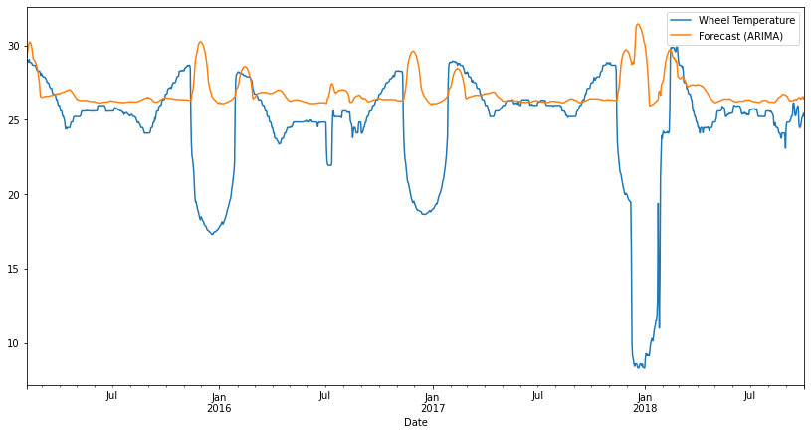
Model Training – Momentum Wheel temperature
Dataset: 769,746 samples of temperature every 10 minutes for ~14.5 years from LASP (CU Boulder)
Sampled down to daily mean (5346 samples)
ARIMA requires stationary data, so rolling mean and std dev with multiple window sizes used as features
Trained model on first ~75% of dataset
Validated/tested model on last ~25% of dataset
Exogenous features: variables not affected by other variables in the system
Used bus current/voltage and battery temperature in the same timeframe to add additional features
Optimal hyperparameters calculated: (p,d,q) = (3,0,4)
Seasonal parameters did not provide any significant improvements in results and took much longer time to train (~11x longer)
Using ARIMA with single feature leads to inaccurate results and a forecast that doesn’t model the truth data at all
RMSE: 4.9455
MAE: 2.7318
Need to utilize multiple exogenous features to improve accuracy of model

Slide 12
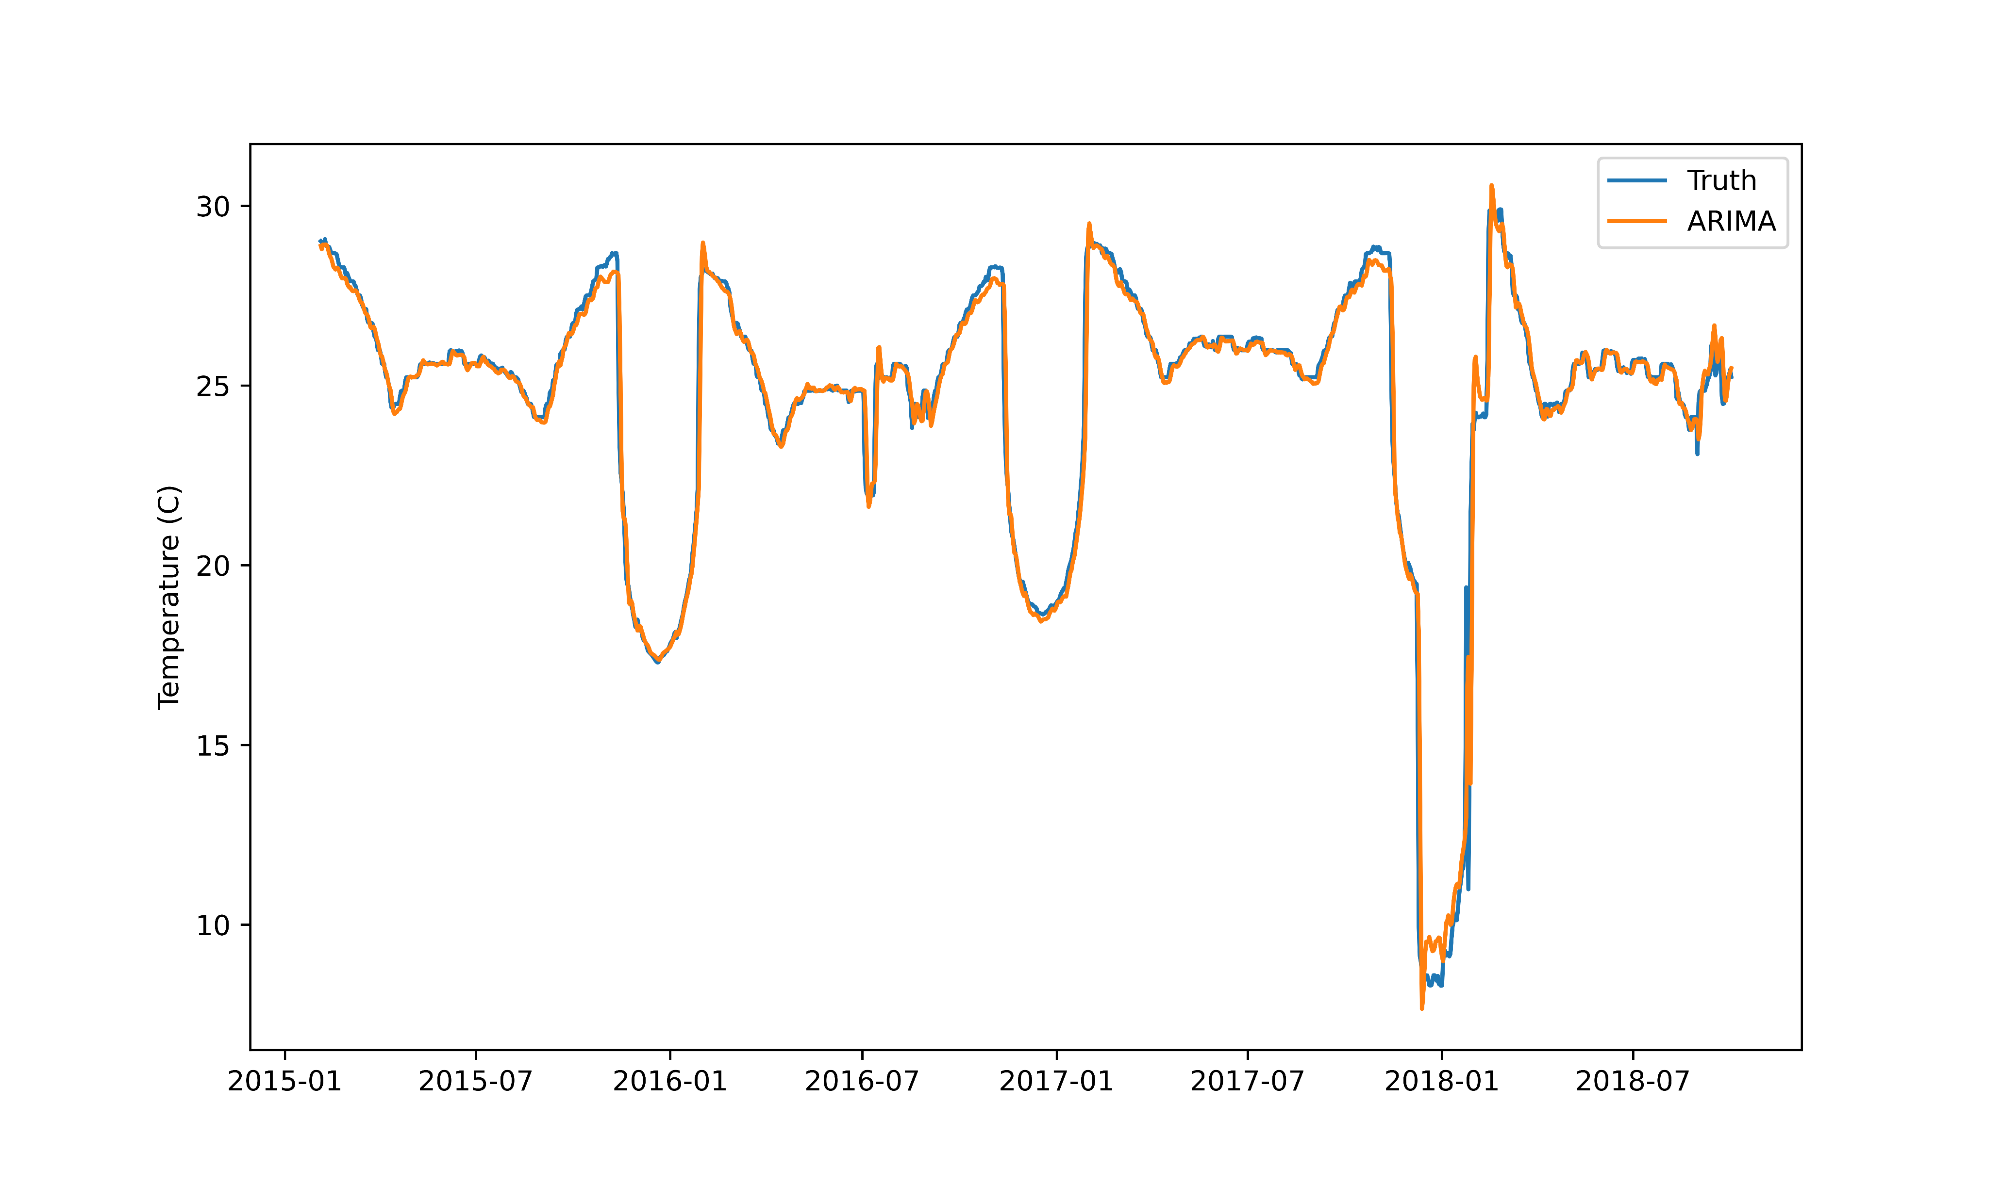
ARIMA Model results
ARIMA forecast results have moderate error, but closely predicted truth data
RMSE of ARIMA: 0.64958
MAE of ARIMA: 0.26931
Utilizing 28 exogenous features did not appear to overfit the model
2nd step of outlier detection utilized OCSVM and Isolation Forest
Isolation Forest meant to be used to compare against OCSVM to prove it is better choice

Slide 13
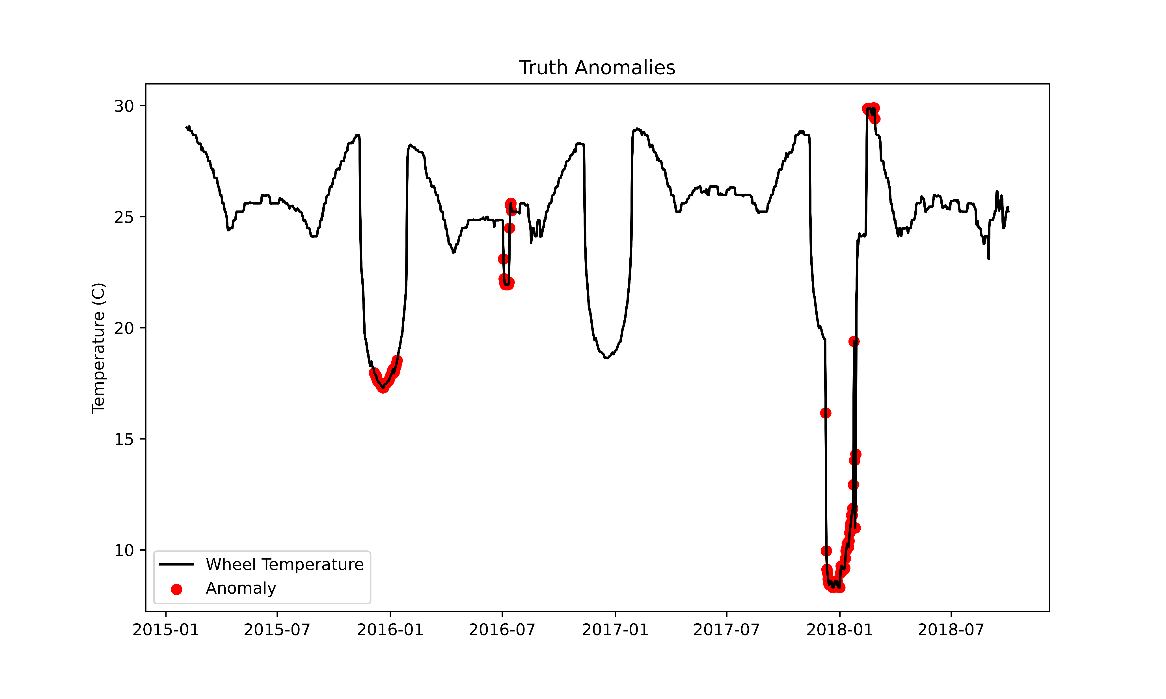
Results – Truth anomalies
Taking truth/validation data, manually marked data points as anomalies
115/1337 total points selected (marked in red)
4 separate “anomaly events” identified
3 “point” anomalies (#1/3/4)
1 “pattern” anomaly (#2)
Hardest type of anomaly to predict
Truth points compared to forecast data to calculate evaluation predictors
Precision
Recall/Sensitivity
F1-score (accuracy)
False Positive Rate (FPR)
#4
#2
#1
#3

Slide 14
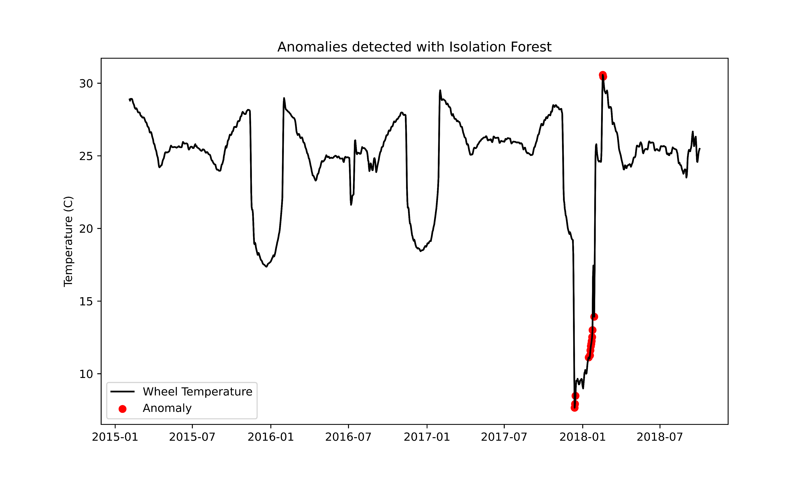
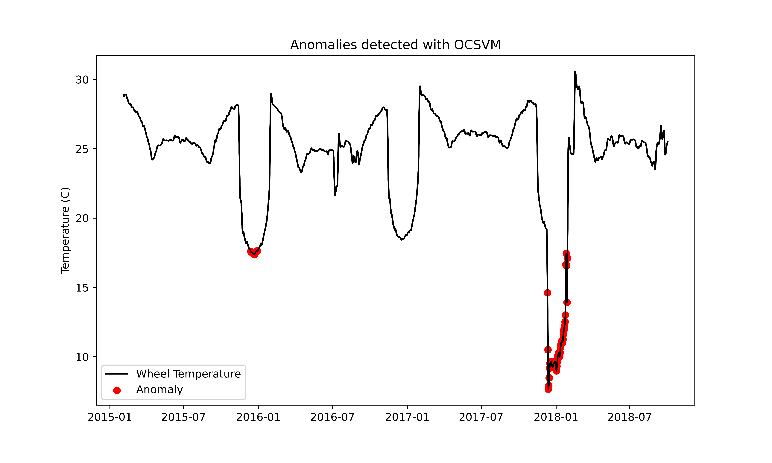
Results – OCSVM and Isolation forest outlier detection
ML Method | Outlier Detection Method | F1 | Recall | Precision | FPR
ARIMA | OCSVM | 0.72528 | 0.57391 | 0.98508 | 0.00082
ARIMA | Isolation Forest | 0.20155 | 0.11304 | 0.92857 | 0.00082

Slide 15
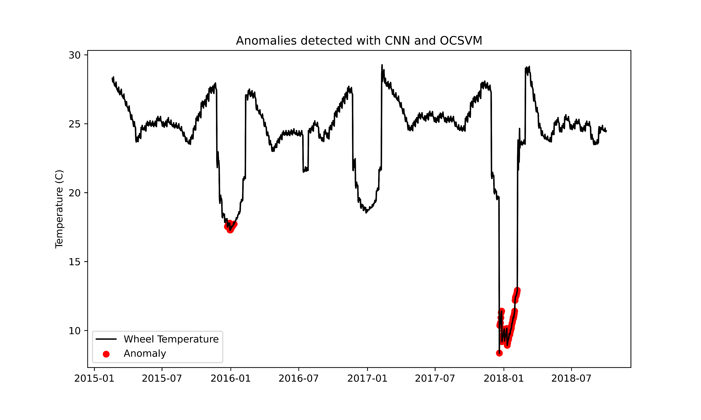
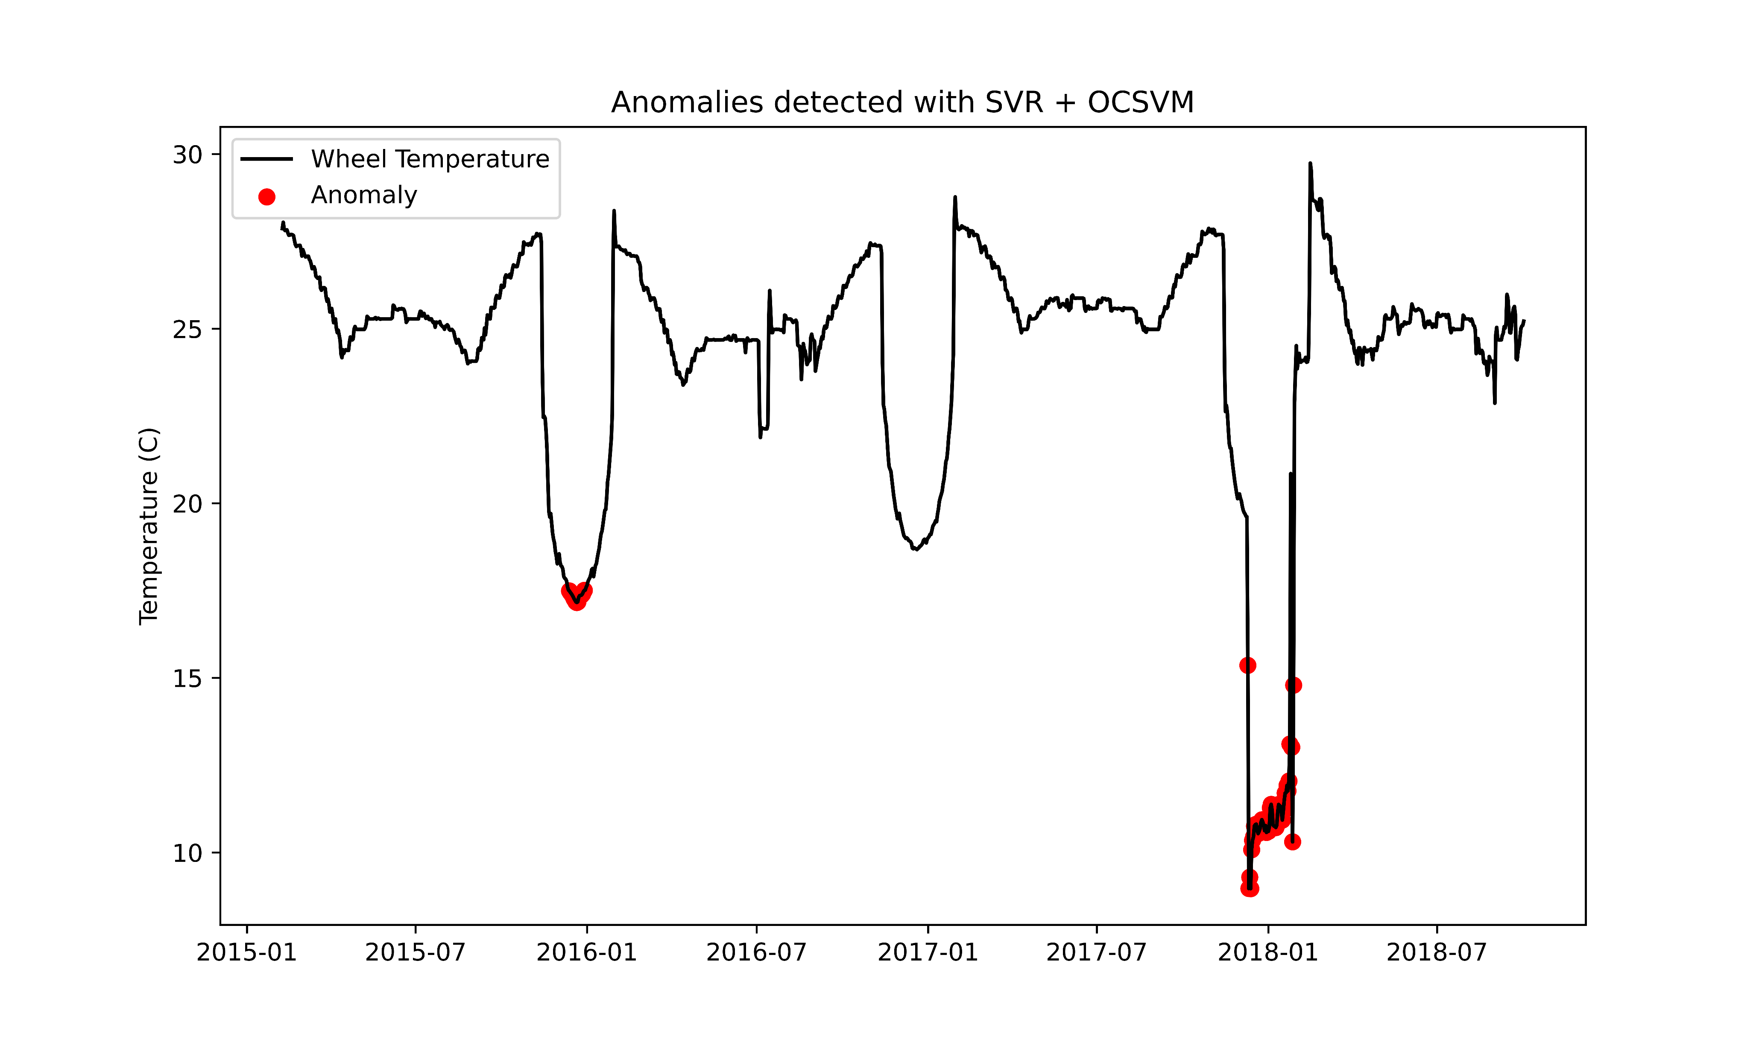
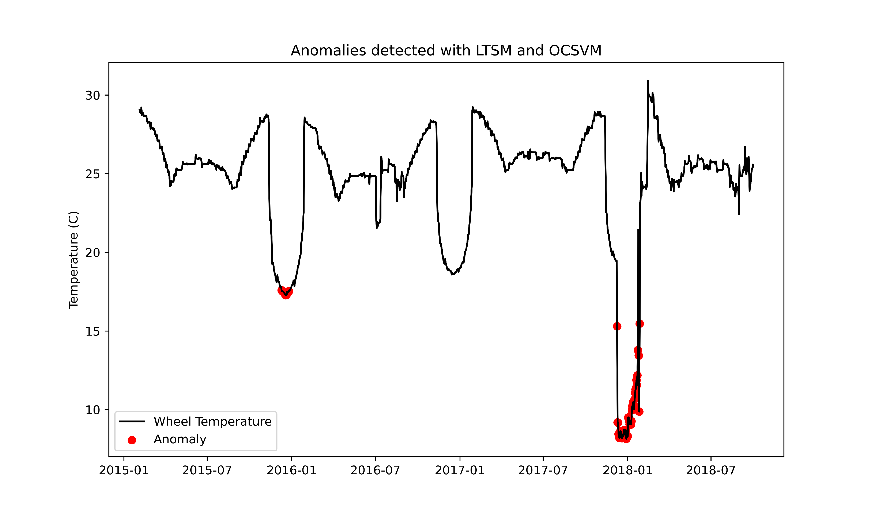
Results – comparison methods
ML Method | Outlier Detection Method | F1 | Recall | Precision | FPR
ARIMA | OCSVM | 0.72528 | 0.57391 | 0.98508 | 0.00082
ARIMA | Isolation Forest | 0.20155 | 0.11304 | 0.92857 | 0.00082
CNN | OCSVM | 0.62637 | 0.49565 | 0.8507 | 0.00082
LSTM | OCSVM | 0.71832 | 0.56521 | 0.98484 | 0.00082
SVR | OCSVM | 0.71832 | 0.56521 | 0.98484 | 0.00082

Slide 16
Intermediate conclusions
Combination of ARIMA and OCSVM optimal choice for identifying anomalies with selected dataset and chosen algorithms
OCSVM and Isolation Forest not ideal for pattern anomalies but worked well with point anomalies with extremely low FPR
LSTM performed with the lowest error but forecasted anomalies at the same rate as other methods
The combination of ARIMA model fitting of data and using OCSVM to identify outliers was used on other spacecraft telemetry with similar results as seen with the momentum wheel temperature data
Issues with previous analysis:
Finding datasets with multiple types of sensor data (temperature/voltage/counters/etc) over same time period
Original ARIMA method not ideal for correctly identifying pattern anomalies
ML Method | RMSE | MAE
ARIMA (m=12) | 0.61517039 | 0.26281167
ARIMA (m=1) | 0.61416997 | 0.26359404
CNN | 1.45571998 | 0.86929778
LTSM | 0.45972694 | 0.12007044
SVR | 0.71570473 | 0.47515763

Slide 17
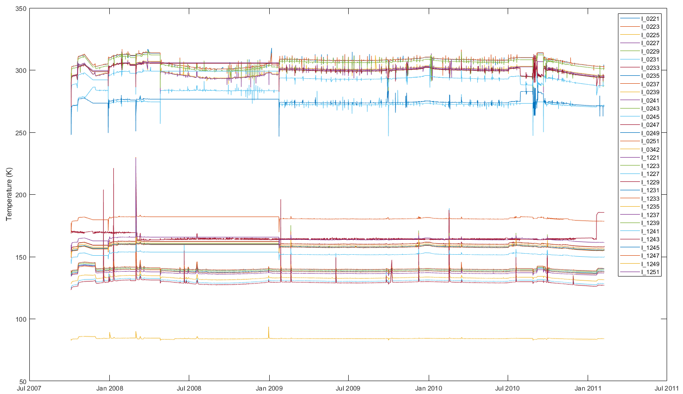
NASA Epoxi mission dataset
Dataset containing 32 temperature measurements from 2 sensors on NASA’s Deep Impact/EPOXI spacecraft were analyzed (HRI & MRI)
High Resolution Instrument: combination visible light multi spectral camera and infrared spectrometer
Medium Resolution Instrument: functional backup for HRI, smaller aperture (12 cm vs 30 cm)
Different materials, size, and offset location on the spacecraft allowed for varied values
Timespan: 10/04/2007 – 02/07/2011 during secondary mission (post comet impact)
More realistic set of telemetry data compared to previously used dataset
Obstacle: sporadic data, 1 sample every 20 minutes with occasional large 12+ hour gaps

Slide 18
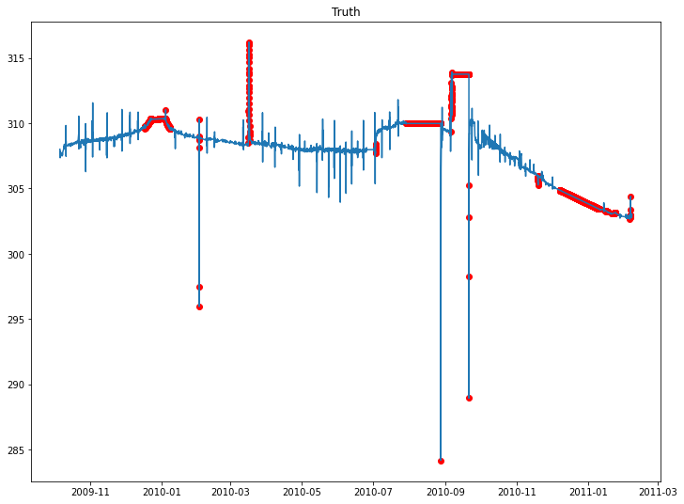
Epoxi dataset truth definition
2631 out of 11731 points marked as anomalous
~20% of total data
Linear interpolation of sparse data created long periods of anomalous data
Contains several transient, collective, and correlation anomalies
Contextual anomalies difficult to identify without more knowledge of system and/or mission

Slide 19
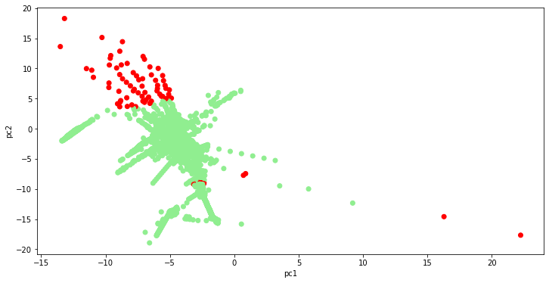
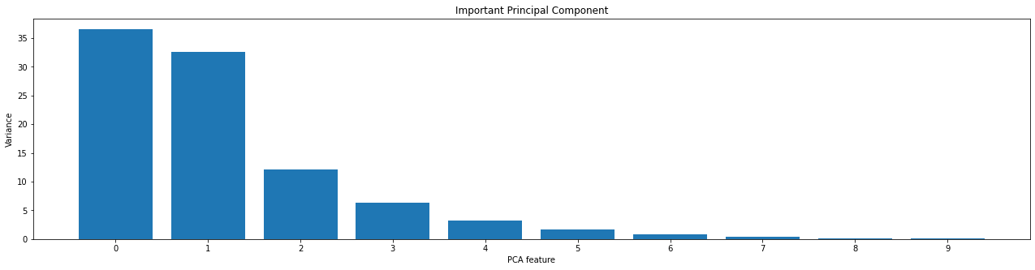
Principal component analysis (PCA)
Dimensionality reduction of multiple sets of data into a lower dimensional space, while preserving critical information (patterns/relationships) from original data
Beneficial for large data sets
Allows for higher accuracy compared to training with all original features
First 2 principal components account for > 70% of the variation of this dataset
Visually useful to identify clusters and outlier datapoints

Slide 20
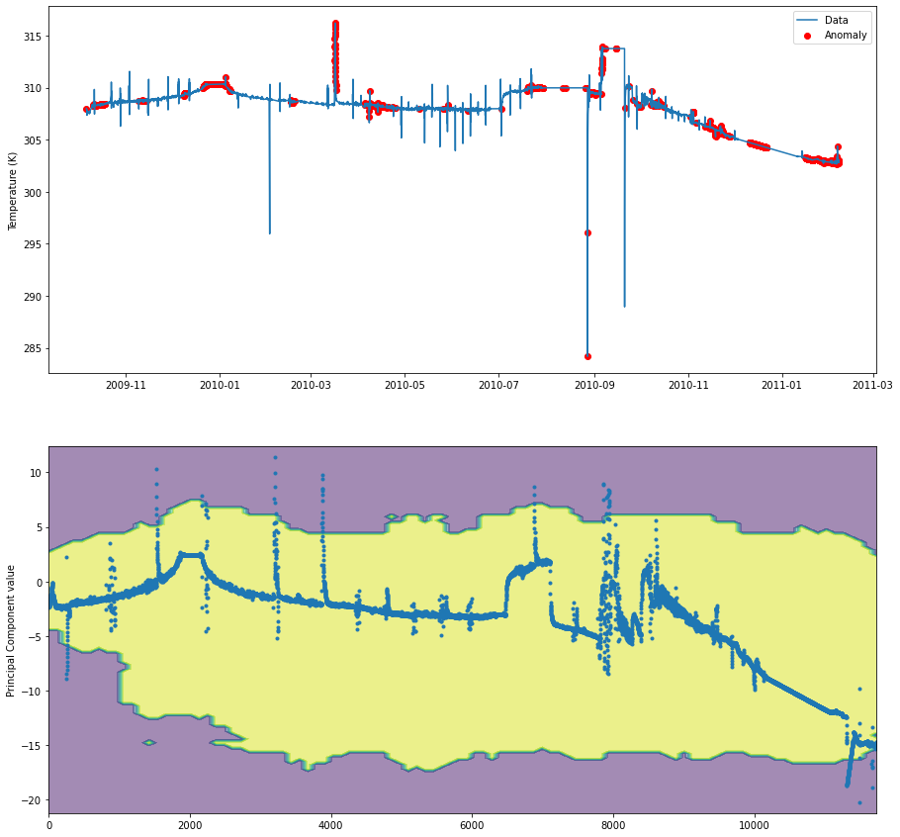
PCA with Isolation forest outlier detection
Utilized PCA to reduce the original dataset of 32 features to just 2 (based on previous slides plot), and then performed a fit for prediction of future data
Isolation Forest and OCSVM were used on transformed data to identify outliers
Outlier point indices overlayed onto original temperature values to identify anomalies
Decision boundary highlights where model defined each hyperplane to split each class
Most data is inside of the yellow space, while the outliers can be seen to generally be outside in the purple space

Slide 21
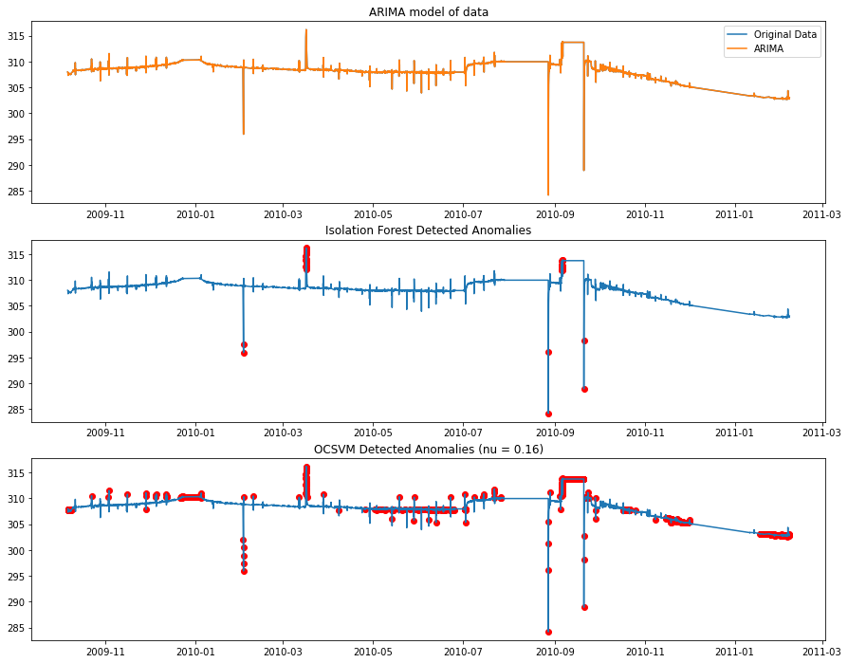
ARIMA with new data
Training ARIMA model with single feature as training data and other features as exogenous features led to very low error fit
RMSE: 1.968e-05, MAE: 1.426e-05
Isolation Forest outlier detection performed with high precision, but only identified a small amount of points
OCSVM identified multitude of incorrect outliers, leading to fairly low accuracy
Utilizing ARIMA prediction on PCA fit data produced unusable results
Additional preprocessing likely needed

Slide 22
Final Results and conclusions
PCA allowed for highest F1/accuracy and recall when used in combination with OCSVM
Fairly high precision and low FPR (~9%), but not as optimal as ARIMA methods
ARIMA prediction still performs with highest precision and lowest FPR when paired with Isolation Forest
Very low F1 and recall scores
High precision but low F1 can sometimes indicate that the model was underfit
Future work:
Find more varied datasets with similar or more number of features, and different component SOH parameters
Attempt to identify contextual anomalies
Keep F1 high while keeping FPR low as possible
Score | F1 | Recall | Precision | FPR
Isolation Forest (PCA) | 0.41733 | 0.30027 | 0.68398 | 0.04011
OCSVM (PCA) | 0.75229 | 0.79704 | 0.71230 | 0.09308
KMEANS (PCA) | 0.02111 | 0.01102 | 0.24786 | 0.00967
LSTM then ISO (PCA) | 0.03929 | 0.02052 | 0.45763 | 0.00703
LSTM then OCSVM (PCA) | 0.35935 | 0.31585 | 0.41675 | 0.12780
ARIMA then ISO (ARIMA) | 0.08295 | 0.04332 | 0.97297 | 0.00009
ARIMA then OCSVM (ARIMA) | 0.36722 | 0.31509 | 0.44002 | 0.11593

Slide 23
Questions?

Slide 24
Bibliography
[1] https://digitalcommons.usu.edu/cgi/viewcontent.cgi?article=5002&context=smallsat
[2] https://github.com/sapols/Satellite-Telemetry-Anomaly-Detection
[3] https://www.hindawi.com/journals/ijae/2022/1676933/
[4] https://pubmed.ncbi.nlm.nih.gov/36080816/
[5] https://github.com/drewthayer/time-series-forecasting-CNN
[6] https://github.com/microsoft/ML-For-Beginners
[7] https://www.mdpi.com/1424-8220/22/17/6358
[8] https://towardsdatascience.com/tods-detecting-outliers-from-time-series-data-2d4bd2e91381
[9] https://www.tutorialspoint.com/time_series/time_series_lstm_model.htm

